Slide 1

Spring “Framework”

Slide 2

Agenda
BASICS OF SPRING
Spring core
Defining Beans
Bean Lifecycle
Bean Scopes

Slide 3
1
BASICS OF SPRING

Slide 4
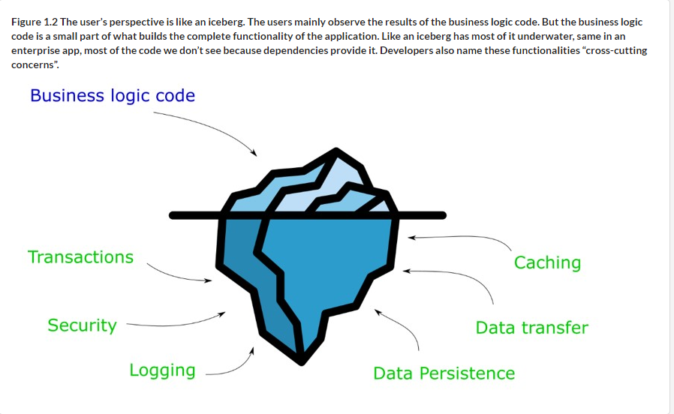

BASICS OF SPRING
Notes:
https://livebook.manning.com/book/spring-quickly/chapter-1/v-6/96
why is Spring so appreciated, and when should you even use it?
The Spring framework is an application framework that is part of the Java ecosystem.
An application framework is a set of common software functionalities that provides a foundation structure for developing an application.
An application framework is a set of functionalities on top of which we build applications. The application framework provides us a broad set of tools and functionalities that you can use to build apps. You don’t need to use all of the features the framework offers. Depending on the requirements of the app you make, you’ll choose the right parts of the framework to use.
!!! An application framework eases the effort of writing an application by taking out the effort of writing all the program code from scratch.
Spring is the most used Java framework today. It become so popular that we can now see: Spring with Kotlin
Common patterns between apps:
Logging
Data storing
Data transfer
Transactions
Protection mech against vulnerabilities
Communication between apps
Improve performance: caching or compression

Slide 5
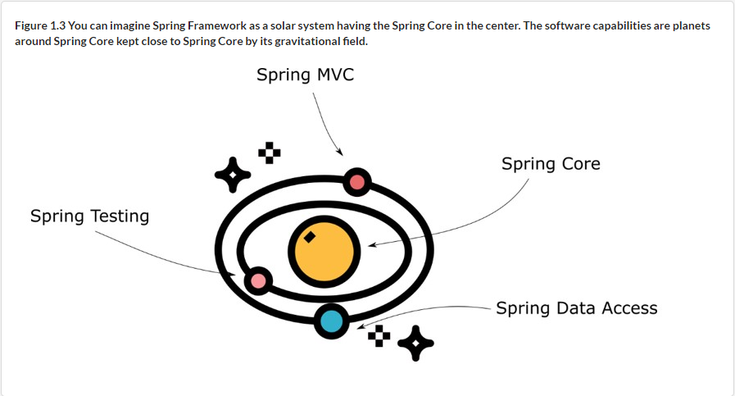


BASICS OF SPRING
Spring is an ecosystem of frameworks and not just one framework
Notes:
https://livebook.manning.com/book/spring-quickly/chapter-1/v-6/52
Spring dependencies are part of the org.springframework group ID
An application framework eases the effort of writing an application by taking out the effort of writing all the program code from scratch.
Spring is an ecosystem of frameworks and not just one framework.
Spring includes frameworks for:
Spring core (contains String Context, Aspects, SpEL,
Spring Data Access: helps implementing persistence layer
Spring MVC
Spring Testing

Slide 6
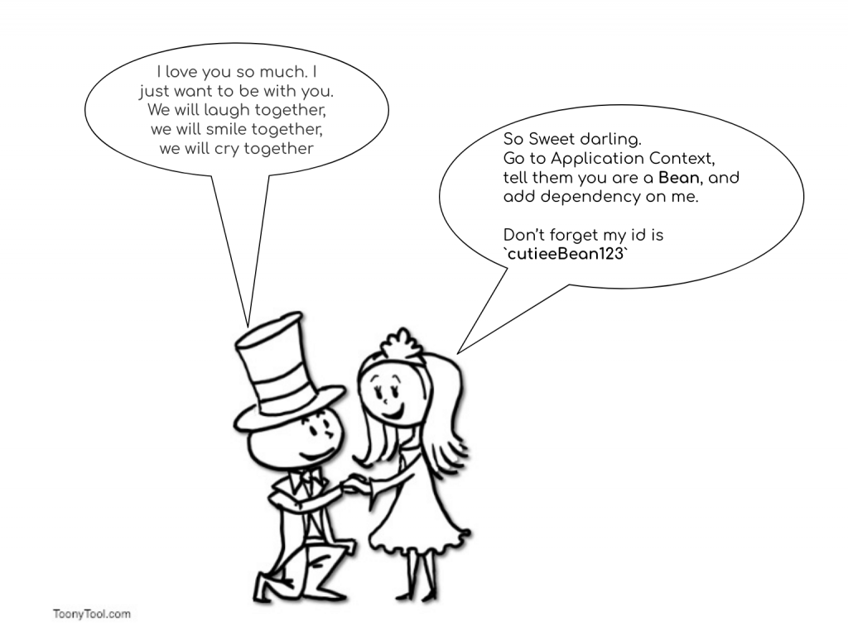
BASICS OF SPRING

Slide 7
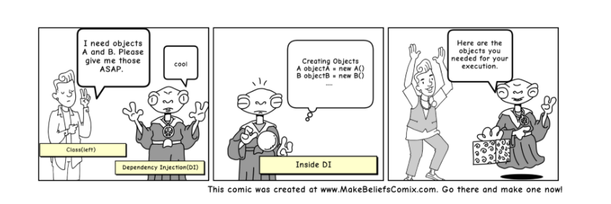
BASICS OF SPRING

Slide 8

BASICS OF SPRING
Notes:
Alexa

Slide 9
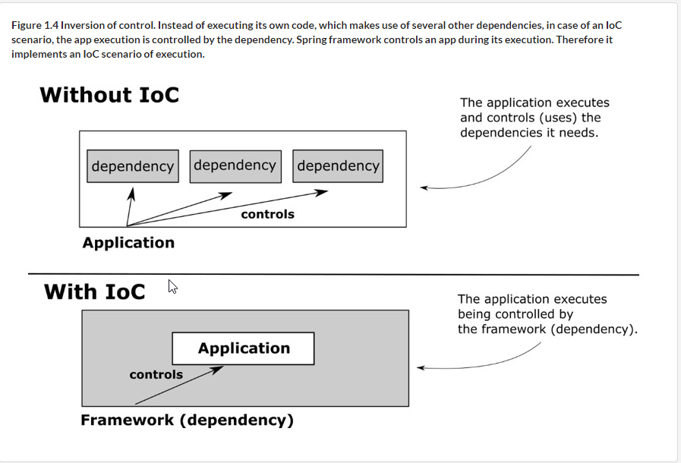
BASICS OF SPRING
Notes:
https://livebook.manning.com/book/spring-quickly/chapter-1/v-6/52

Slide 10
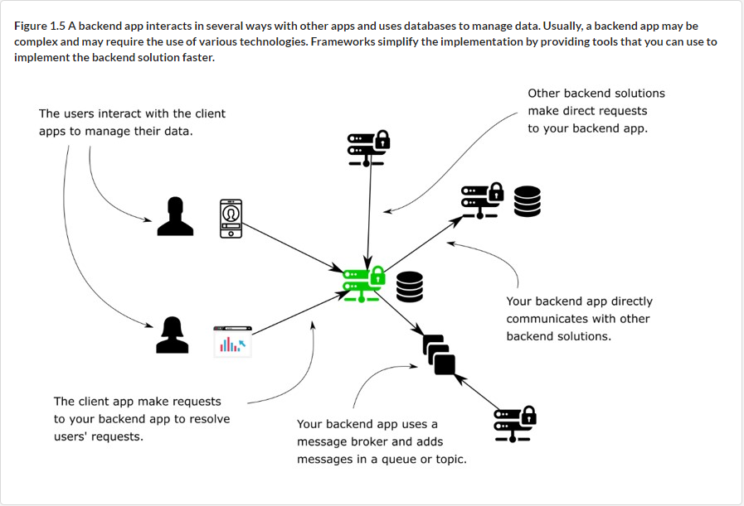
BASICS OF SPRING
Notes:
https://livebook.manning.com/book/spring-quickly/chapter-1/v-6/96

Slide 11
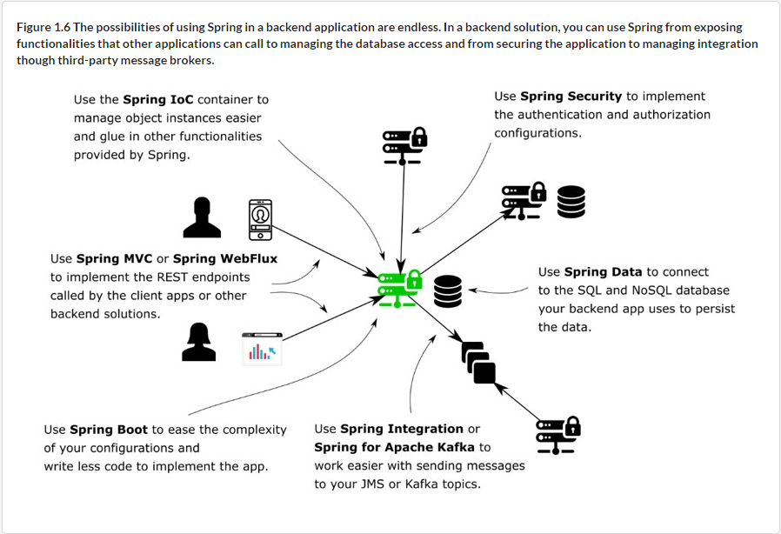
BASICS OF SPRING
Notes:
https://livebook.manning.com/book/spring-quickly/chapter-1/v-6/52

Slide 12
2
BEAN

Slide 13
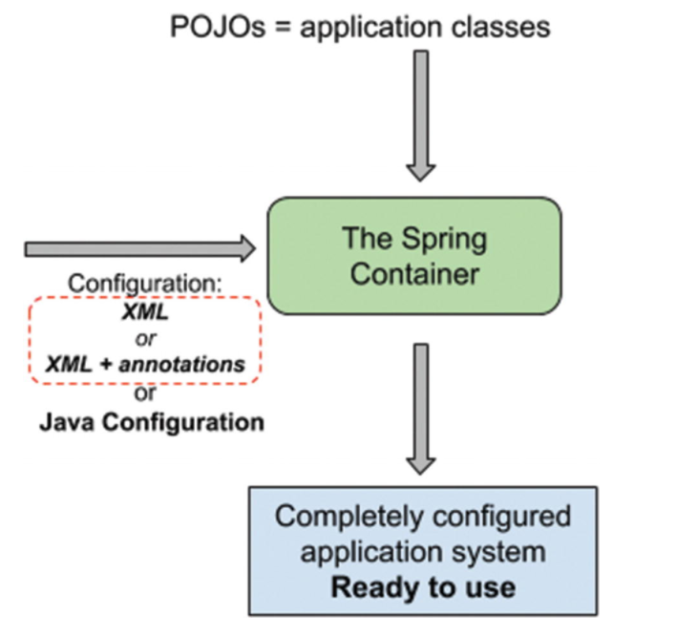
Spring ecosystem
Notes:
https://learning.oreilly.com/library/view/pivotal-certified-professional/9781484251362/html/336364_2_En_2_Chapter.xhtml

Slide 14
2
Spring Core

Slide 15
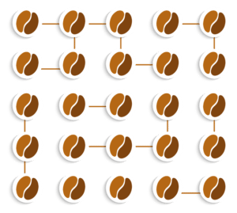
Spring Context
Place in the app’s memory that the framework uses to keep the objects it manages
Objects are stored with their dependencies
Notes:
Adding objects to the Spring context without needing the framework to manage them adds unnecessary complexity to your app, making the app both more challenging to maintain and less performant.
When you add an object to the Spring context, you allow the framework to manage it with some specific functionality the framework provides. If you add the object to be managed by Spring without getting any benefit from the framework, you just over-engineer your implementation.

Slide 16
BeanFactory
+ Bean instantiation/wiring
ApplicationContext
+ Bean instantiation/wiring + Ability to read values of bean properties for properties file. (@PropertySource)
+ Supports internationalization (i18n)
+ Ability to work with events and listeners
BeanFactory Vs ApplicationContext
!!! Use an ApplicationContext unless you have a good reason for not doing so.
Notes:
https://docs.spring.io/spring-framework/docs/current/reference/html/core.html#spring-core
ApplicationContext includes all functionality of the BeanFactory
Reason for not using ApplicationContext: an Applet where memory consumption might be critical, and a few extra kilobytes might make a difference
@Configuration gives you the ability use many other features with conjunction of other annotations:
Importing other config @Import(DatabaseConfig.class)
resource import @PropertySource("classpath:config.properties")
enable component scan @ComponentScan(basePackages = { "com.sample.*" })
marking profile @Profile("production")
To enable features @Enablexxxx

Slide 17




Application context functionalities
Register beans
Publish events
Spring core
Internationalization (i18N)
Access to resources

Slide 18


Types of ApplicationContext implementations
org.springframework.context.annotation. AnnotationConfigApplicationContext
org.springframework.web.context.support. AnnotationConfigWebApplicationContext
org.springframework.context.support. ClassPathXmlApplicationContext
Standalone application context, accepting annotated classes as input - in particular @Configuration-annotated classes, but also plain @Component types and JSR-330 compliant classes using javax.inject annotations. Allows for registering classes one by one using register(Class...) as well as for classpath scanning using scan(String...).
This is essentially the equivalent of AnnotationConfigApplicationContext for a web environment.
Standalone XML application context, taking the context definition files from the class path, interpreting plain paths as class path resource names that include the package path (e.g. "mypackage/myresource.txt"). Useful for test harnesses as well as for application contexts embedded within JARs.
!!! For all available implementations for ApplicationContext interface: https://docs.spring.io/spring-framework/docs/current/javadoc-api/org/springframework/context/ApplicationContext.html

Slide 19
3
Defining Beans

Slide 20
How to add new beans to the spring context
USING XML FILES
Using @Bean ANNOTATION
Defining beans
USING STEREOTYPE ANNOTATIONS
PROGRAMMATICALLY

Slide 21
Used for adding to the Spring Context:
instances of the classes you defined
Instances of classes you didn’t create yourself, but you use in your app
@Bean
Annotation
@Bean Methods in @Configuration Classes
'inter-bean references’ bean methods may reference other @Bean methods in the same class by calling them directly
@Bean Lite Mode
@Bean methods declared in other classes
'inter-bean references' are NOT supported in lite mode (invocation is a standard Java method invocation; Spring does not intercept the invocation
Notes:
!!! Spring can manage only the objects that are part of it
A configuration class is a special class in Spring applications that we use to instruct Spring to do specific actions. For example, we can tell Spring to create beans or to enable certain functionalities.
We can also specify spring bean init method and destroy method. These methods are called when spring bean is being created and when the context is being closed respectively.
@Bean(name= {"getMyFileSystemBean","MyFileSystemBean"}, initMethod="init", destroyMethod="destroy")
public MyFileSystemBean getMyFileSystemBean()
{
return new MyFileSystemBean();
}
!!! “init” method is being called when context refresh method is invoked and “destroy” method is called when context close method is invoked.
Best Practices:
-method doesn’t contain a verb. You probably learned that a Java best practice is to put verbs in method names because the methods generally represent actions. But for methods we use to add beans in the Spring context, we don’t follow this convention. Such methods represent the object instances they return and that will now be part of the Spring context. The method’s name also becomes the bean’s name. By convention, you can use nouns, and most often they have the same name as the class.
@Bean in @Configuration
@Configuration gives you the ability use many other features with conjunction of other annotations:
Importing other config @Import(DatabaseConfig.class)
resource import @PropertySource("classpath:config.properties")
enable component scan @ComponentScan(basePackages = { "com.sample.*" })
marking profile @Profile("production")
To enable features @Enablexxxx
@Bean Lite Mode
- 'inter-bean references' are not supported in lite mode (invocation is a standard Java method invocation; Spring does not intercept the invocation)

Slide 22
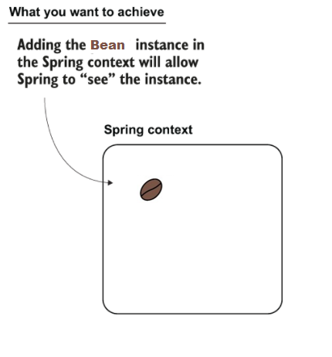
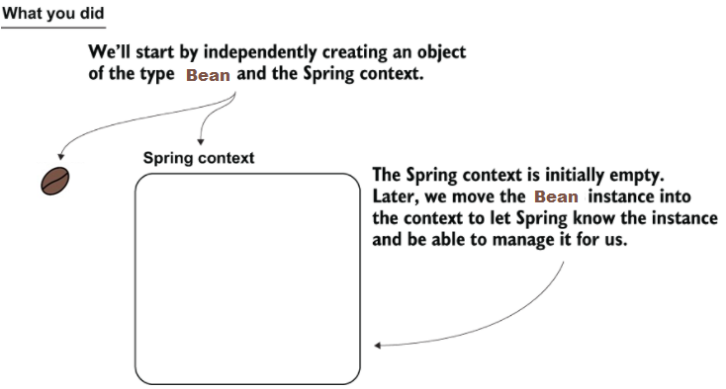
Defining BEANS
Notes:
Your objective is to add the Bean object to the context.

Slide 23
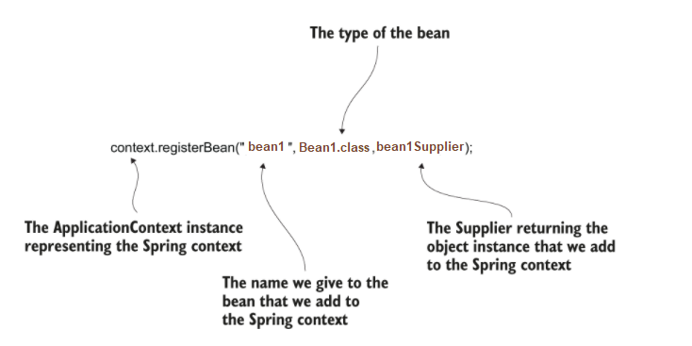
Programmatically
Notes:
https://learning.oreilly.com/api/v2/epubs/urn:orm:book:9781617298691/files/Images/CH02_F14_Spilca2.png
Supplier<Bean1> bean1Supplier = () -> x;

Slide 24





Advantages
Control over the instance is permitted only after the frameworks creates it
Only one instance of the class in the context
Stereotypes Annotations
Only applied for the classes OWNED BY THE app
Cleaner code
preferred option for defining beans
Notes:
Using @Component is generic and gives you no detail about the responsibility of the object you’re implementing
Spring offers us the @Service annotation to mark a component that takes the responsibility of a service and the @Repository annotation to mark a component that implements a repository responsibility
@Service, @Repository,@Controller helps with defining an extra intent for the class (metadata).
Stereotype annotations are used to mark classes according to their purpose.
@Component: template for any Spring-managed component(bean).
@Repository: template for a component used to provide data access, specialization of the @Component annotation for the DAO layer.
@Service: template for a component that provides service execution, specialization of the @Component annotation for the Service layer.
@Controller: template for a web component, specialization of the @Component annotation for the web layer.7
@Configuration: configuration class containing bean definitions (methods annotated with @Bean).8

Slide 25
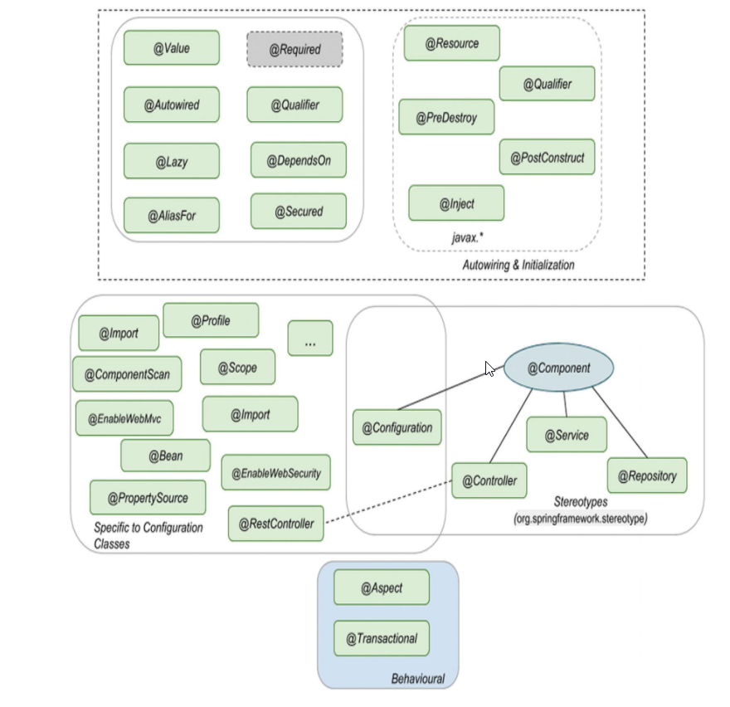
Spring Annotations
Notes:
https://learning.oreilly.com/library/view/pivotal-certified-professional/9781484251362/html/336364_2_En_2_Chapter.xhtml
The core annotation in Spring is the @Component from the org.springframework.stereotype package.
Classes are automatically picked up using annotation-based configuration (classes annotated with @Configuration) and classpath scanning (enabled by annotating a configuration class with @ComponentScan)
@Autowired: core annotation for this group; is used on dependencies to instruct the Spring IoC to take care of injecting them. Can be used on fields, constructors, setters and even methods mentioned in the Injection Types section. Use with @Qualifier from Spring to specify name of the bean to inject.
@Inject: equivalent annotation to @Autowired from javax.inject package. Use with @Qualifier from javax.inject to specify name of the bean to inject.
@Resource: equivalent annotation to @Autowired from javax.annotation package. Provides a name attribute to specify name of the bean to inject.
@Required: Spring annotation that marks a dependency as mandatory. It can be used on setter methods, but since Spring 5.1 was deprecated as of in favor of using constructor injection for required settings.
@Lazy: dependency will be injected the first time it is used. Although this annotation exists, avoid using it if possible. When a Spring application is started ApplicationContext implementations eagerly create and configure all singleton beans as part of the initialization process, this is useful because configuration errors in the configuration or supporting environment (e.g., database) can be spotted fast. When @Lazy is being used spotting these errors might be delayed.

Slide 26
4
Bean Lifecycle

Slide 27
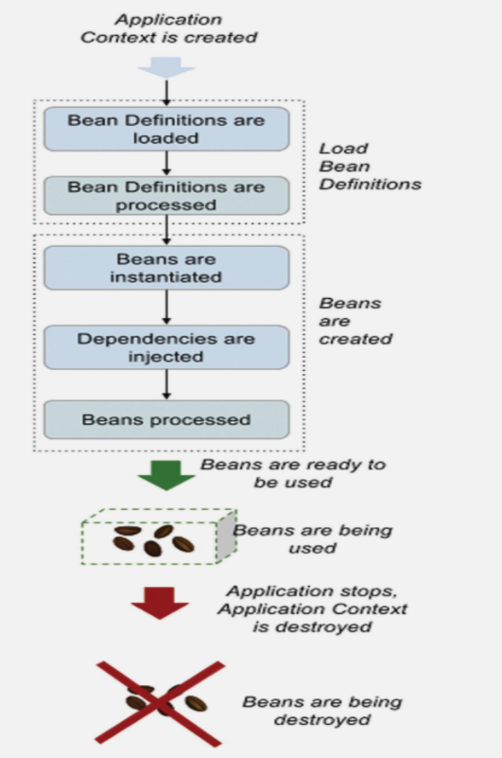
Bean Lifecycle
Notes:
https://learning.oreilly.com/library/view/pivotal-certified-professional/9781484251362/html/336364_2_En_2_Chapter.xhtml
Injection Points: Mecanisme prin care noi putem interveni in procesul de creare/distrugere
@PostConstruct to manage the instance after its creation (javax.annotation-api) Before Java 11, the Java EE dependencies (javax.annotation-api) were part of the JDK.
@PreDestroy
@PostConstruct , @PreDestroy are detected only when using @ComponentScan

Slide 28
6
Wiring Beans

Slide 29
How to create Links between beans
USING Direct method call for @Bean
Using @Bean annotated method’s parameters
Wiring beans
USING @Autowire ANNOTATIONS

Slide 30
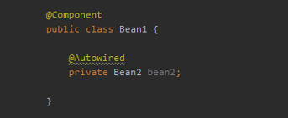

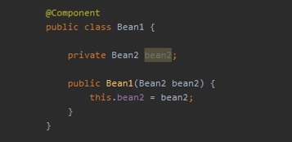

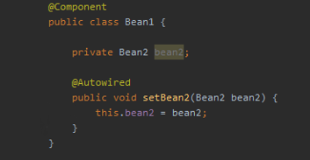

Field Injection
Constructor Injection
Dependency Injection Types
Setter Injection
Notes:
Field Injection uses reflection to set the values of private variables
Constructor Injection happens at the time of creating the object itself (NOTE Starting with Spring version 4.3, when you only have one constructor in the class, you can omit writing the @Autowired annotation.)
Setter Injection uses setters to set the value

Slide 31
Dependency Injection Consideration
Feature | Field injection | Constructor injection | Setter injection
Reliability | Less reliable (you don’t have the option to make the field final) | More reliable because of immutable variables | Less reliable (you don’t have the option to make the field final)
Maintainability | Since @Autowired fields ca easily mix up with regular fields, it gets difficult to track dependencies in the class | Easier to identify the dependencies, as they can be seen in the constructor. | Same as Field injection.
Testability | Mocking becomes challenging. Creating mock beans and actual beans and shuffle between them. | Mocking dependencies becomes easier as they can be marked and passed to the constructor even without creating a Spring Context. Faster and cleaner tests. | Mocking is easy as mocking an object.
flexibility | Adding new dependencies is easier. | Less flexible, as it imposes strict design rules In the code. | Same as Field injection.
Modification on code | Freedom to add unlimited new dependencies. | Follows Open-Closed principle of SOLID. | Same as Field injection.
Cyclic dependency injection | Does not detect cyclic dependencies. | Easily detected and fixed using constructor pattern. | Same as Field injection.
performance | Since each object will be created independently and dependency is injected later using reflection, startup time is faster. | Constructor injection means all beans have to be created in the correct order od dependencies which in turn increases the startup time od the application. | Since each object will be created independently and dependency is injected later, startup time is faster
!!! Constructor Injection is always first choice when it comes to Dependency Injection because of its reliable and strict nature.
Notes:
Other Considerations
One key point that is widely discussed when talking about Field Injection vs Constructor Injection is Required and Optional Dependencies
Many debate that we can use Field Injection for optional and Constructor Injection for required dependencies, but having optional dependency itself seems to be a bad design in most of the cases.
Since the scope of optional dependency is an Unrestricted Territory, any developer can randomly add multiple dependencies by calling it optional and eventually reduce the quality @ of the overall code.
Personally I feel if you need a dependency in your code then it implies that it is required and if it is optional then why to even include it. This statement is debatable and can vary from person to person.

Slide 32
5
Bean Scopes
Notes:
Using the singleton bean scope
Using eager and lazy instantiation for singleton beans
Using the prototype bean scope
Using beans boils down to three points
Make an object bean in the Spring context only if you need Spring to manage it so that the framework can augment that bean with a specific capability. If the object doesn’t need any capability offered by the framework, you don’t need to make it a bean.
If you need to make an object bean in the Spring context, it should be singleton only if it’s immutable. Avoid designing mutable singleton beans.
If a bean needs to be mutable, an option could be to use the prototype scope, which we discuss in section 5.2.

Slide 33
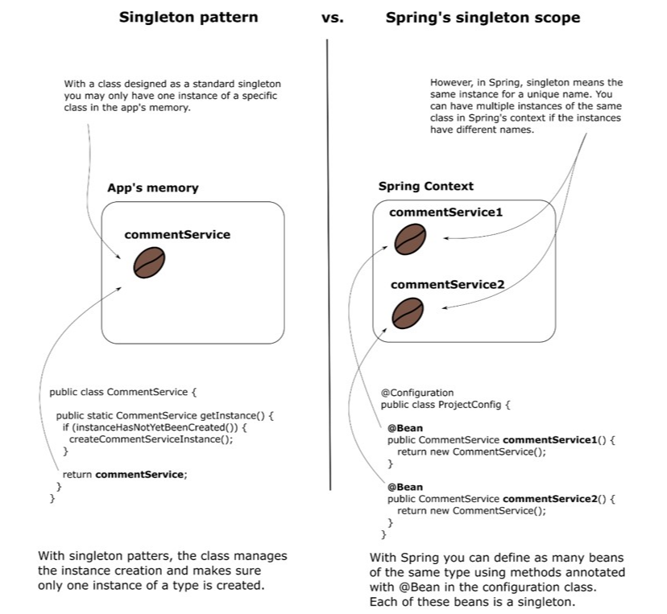
Singleton Scope Spring
Because the singleton bean scope assumes that multiple components of the app can share an object instance, the most important thing to consider is that these beans must be immutable
Notes:
https://livebook.manning.com/book/spring-quickly/chapter-1/v-6/52 You can declare as many instances of the same type as you wish by simply declaring more methods annotated with the @Bean annotation. The unique identifier will be given by the name of the method.
For Spring, the singleton concept allows multiple instances of the same type, and singleton means unique per name but not unique per app
Eager and Lazy
Eager: Spring creates all singleton beans when it initializes the context—this is Spring’s default behavior (eager instantiation)
Lazy: Spring doesn’t create the singleton instances when it creates the context. Instead, it creates each instance the first time someone refers to the bean
In most cases, it’s more comfortable to let the framework create all the instances at the beginning when the context is instantiated (eager); this way, when one instance delegates to another, the second bean already exists in any situation.
!!! Remember: When you define more beans of the same type you can NOT get the beans from the context anymore by only specifying the type. If you do, you’ll get an exception because Spring cannot guess which instance you’ve declared you refer to (org.springframework.beans.factory.NoUniqueBeanDefinitionExceptio).

Slide 34
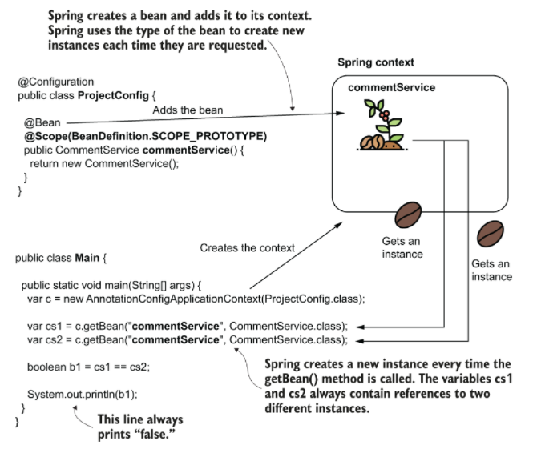
Prototype Scope
Notes:
https://learning.oreilly.com/api/v2/epubs/urn:orm:book:9781617298691/files/Images/CH05_F06_Spilca2.png
For prototype beans, Spring doesn’t create and manage an object instance directly. The framework manages the object’s type and creates a new instance every time someone requests a reference to the bean

Slide 35
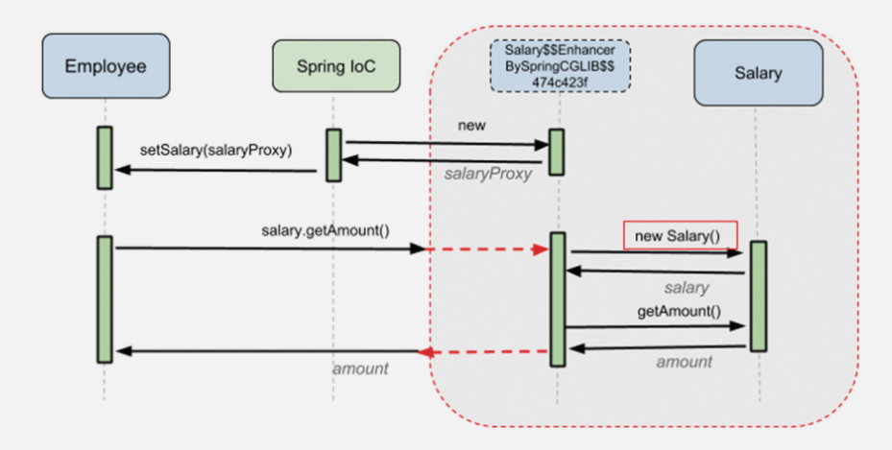
Spring core
Notes:
https://livebook.manning.com/book/spring-quickly/chapter-1/v-6/52

